Slide 1
INDIAN ECONOMIC GROWTH
TEAM:-
B.SAI CHARAN 2203A51L72
SALIM SK 2203A51L53
L.MAMITH KUMAR 2203A51L29

Slide 2
1.INTRODUCTION
1.1.Overview
Strong economic growth in the first quarter of FY 2022-23 helped India overcome the UK to become the fifth-largest economy after it recovered from repeated waves of COVID-19 pandemic shock. Real GDP in the first quarter of 2022–23 is currently about 4% higher than its corresponding 2019-20, indicating a strong start for India's recovery from the pandemic. Given the release of pent-up demand and the widespread vaccination coverage, the contact-intensive services sector will probably be the main driver of development in 2022–2023. Rising employment and substantially increasing private consumption, supported by rising consumer sentiment, will support GDP growth in the coming months.

Slide 3
1.INTRODUCTION
1.2.Existing Economy
India’s nominal gross domestic product (GDP) at current prices is estimated to be at Rs. 232.15 trillion (USD$ 3.12 trillion) in FY22. With more than 100 unicorns valued at USD$ 332.7 billion, India has the third-largest unicorn base in the world. The government is also focusing on renewable sources to generate energy and is planning to achieve 40% of its energy from non-fossil sources by 2030. India is primarily a domestic demand-driven economy, with consumption and investments contributing to 70% of the economic activity. With an improvement in the economic scenario and the Indian economy recovering from the Covid-19 pandemic shock, several investments and developments have been made across various sectors of the economy.

Slide 4
1.INTRODUCTION
1.3.Problem system
The Indian economy growth could be to develop a predictive model that can analyze various economic indicators and provide insights into the factors that influence the growth of the Indian economy. The model can use a range of data sources such as GDP growth rates, inflation rates, employment data, demographic trends, and market trends to identify key drivers of growth in the Indian economy. The model can then be used to forecast future growth trends and suggest policy interventions that can stimulate growth and address the challenges facing the economy. The objective of this project is to help policymakers and business leaders make informed decisions that can drive sustainable economic growth and improve the overall well-being of citizens.

Slide 5
1.INTRODUCTION
1.4.Object definition
The model can then be used to forecast future growth trends and suggest policy interventions that can stimulate growth and address the challenges facing the economy. The objective of this project is to help policymakers and business leaders make informed decisions that can drive sustainable economic growth and improve the overall well-being of citizens.

Slide 6
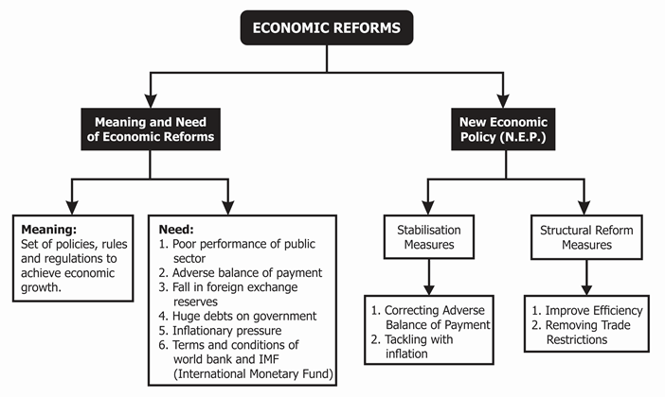
1.5.UML diagram

Slide 7
2.LITERATURE SURVEY
2.1.Related work
"India's Economic Growth: An Analysis of the Role of Demographics, Human Capital and Economic Freedom" by Sanjeev Kumar, Samrat Roy, and Sandhya Duggal: This paper examines the relationship between demographics, human capital, economic freedom and economic growth in India using a panel dataset. The authors find that economic freedom and human capital have a significant positive effect on economic growth in India. "Indian Agriculture and Economic Growth: A Review of Concepts and Evidence" by Ashok Gulati and Shweta Saini: This paper reviews the role of agriculture in driving economic growth in India. The authors argue that agriculture has been a key driver of economic growth in India, particularly in the rural sector.

Slide 8
2.LITERATURE SURVEY
According to a report released on Monday, artificial intelligence (AI) is predicted to boost India's economy by $967 billion by 2035 and its GDP by about $450 to $500 billion by 2025, or about 10% of the country's aim of $5 trillion in GDP.AI is projected to contribute $15.7 trillion to the global economy by 2030.
How will AI impact Indian economy?
AI has the potential to significantly boost the Indian economy by improving productivity, reducing costs and creating opportunities for innovation and growth, says Anurag Sanghai, principal solutions architect at Intellicus Technologies.

Slide 9
3. DATA PRE-PROCESSING
3.1.Data set
Date:-Date refers to the time period where the Indian Economy is taken.
GDP Growth:-GDP is the sum of gross value added by all resident producers in the economy plus any product taxes and minus any subsidies not included in the value of the products. It is calculated without making deductions for depreciation of fabricated assets or for depletion and degradation of natural resources. Source.
Inflation Rate:-In economics, inflation is an increase in the general price level of goods and services in an economy. When the general price level rises, each unit of currency buys fewer goods and services; consequently, inflation corresponds to a reduction in the purchasing power of money. .
GDP Billon USD:-Gross domestic product (GDP) is the total monetary or market value of all the finished goods and services produced within a country's borders in a specific time period. As a broad measure of overall domestic production, it functions as a comprehensive scorecard of a given country's economic health..
Export Value Billion USD:-The value of goods exported to a foreign country by residents according to international trade statistics.

Slide 10
Import Value Billion USD:-With exports worth $453 billion and imports to the tune of $723 billion, India's overall international trade reached $1.17 trillion, 21% above previous year's $969 billion, official data show.
Unemployment:-The unemployment rate is the percentage of the labor force that is looking for a job. The labor force is only a portion of the total population. The ratio of the labor force to the working-age population is called the labor force participation rate.
3.2.Data cleaning
Dropping the null values was not an option since it negatively affected the accuracy. These null values were handled by replacing them with the median value of the column. The replacement was done by implementing the simple function in the pipeline itself. So that any missing value in the future would be handled as soon as the data passes through the pipeline.

Slide 11
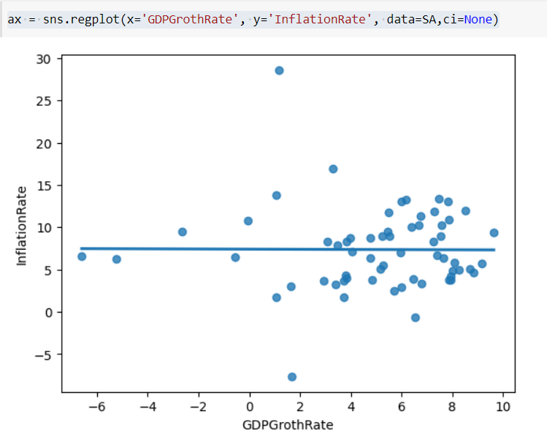
3.3 DATA VISUALIZATION
FIG 3.1: The Above pair plot gives the pair plot between the GDP Growth Rate and Inflation Rate.

Slide 12
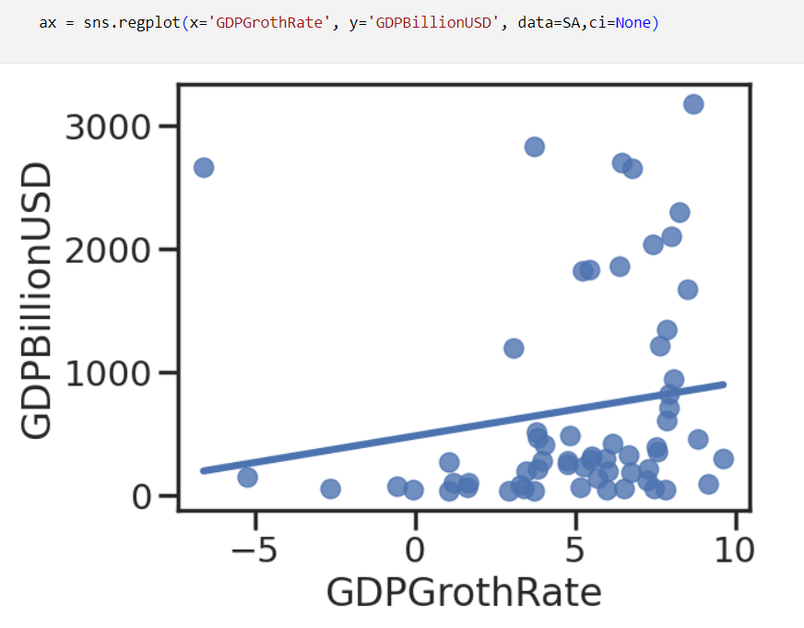
FIG 3.2 DATA VISUALIZATION

Slide 13
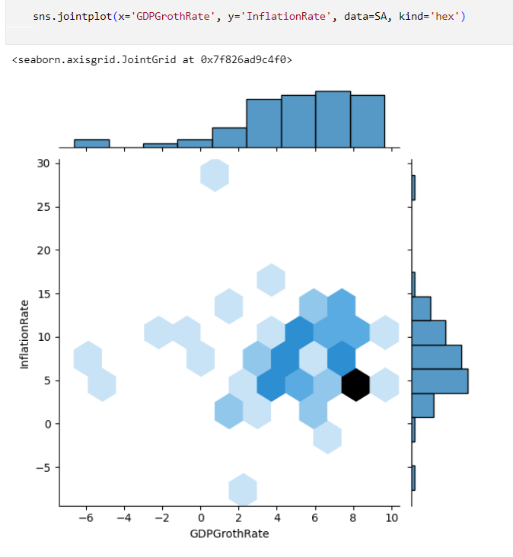
FIG 3.3
The above pair plot gives the join plot between distance of Inflation Rate and GDP Growth Rate in the Indian Economy.

Slide 14
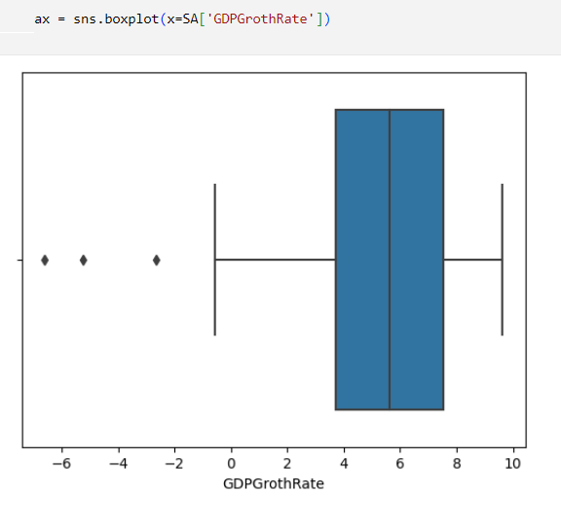
FIG 3.4
The above shows the box plot of “GDP Growth Rate”

Slide 15
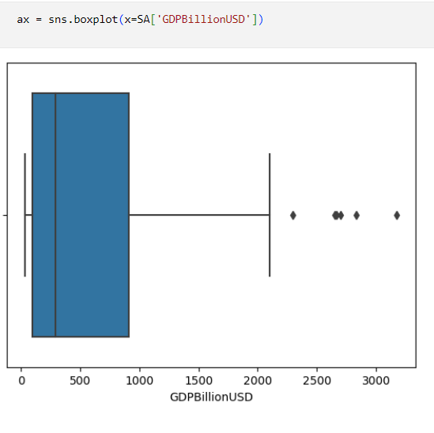
FIG 3.5
The above pair shows the box plot of “GDPBillionUSD”

Slide 16
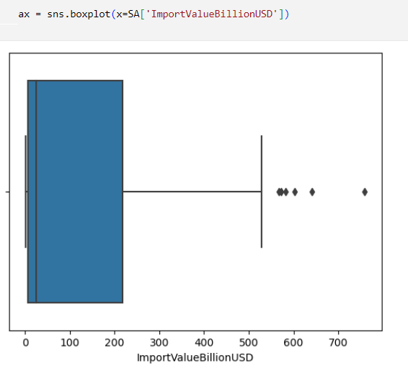
FIG 3.6
The above pair plot shows the box plot of “ImportValueBillionUSD”

Slide 17
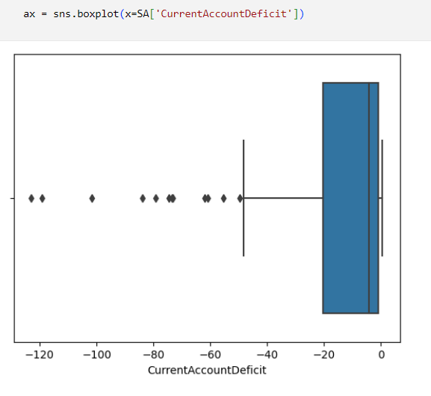
FIG 3.7
The above pair plot box plot of “CurrentAccountDeficit"

Slide 18
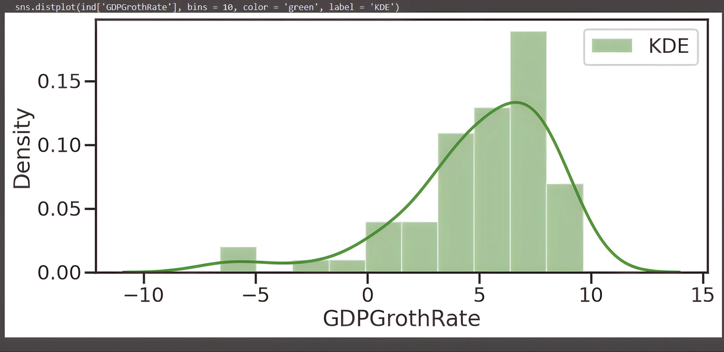
FIG 3.8
The above distplot of “GDP GROWTH RATE"

Slide 19
4.METHODOLOGY
4.1.PROCEDURE TO SOLVE THE PROBLEM
“In the coming years, the contribution from AI to the Indian economy is going to be extremely significant,” says Ganesh Gopalan, chief executive of Gnani.ai, a Bengaluru-based company that provides conversational AI voice bots for customer service automation.
AI is increasingly being used across industries in India — from banking and health care to farming and manufacturing — to improve efficiency by using the intelligence of technology and machines to perform tasks. It can increase the efficiency with which things are done and vastly improve the decision-making process by analysing large amounts of data. It can also spawn the creation of new products and services, markets and industries, thereby boosting consumer demand and generating new revenue streams.

Slide 20
4.METHODOLOGY
4.2.Models used
● Linear regression model
4.3.Software description
In our program we use Python 3 programming language. Python interpreted object
oriented high level programming language with dynamic semantics. It’s high level built in
data structures combined with dynamic typing and dynamic building make it very attractive
for rapid application development as well As for use as a scripting or glue language to
connect existing components together. Pythons. Simply easy to learn syntax emphasizes
readability and therefore reduces the cost of program maintenance. Python support modules
and packages which encourages program modularity and code review. The Python interpreter
and the extensive standard library are available in source or binary form without charge for
all major platforms, and can be free distributed.

Slide 21
5.RESULTS AND DISCUSSION
MODEL USED | MAE | MSE | RMSE
Linear Regression | 3.0593907615985096 | 15.613255839024342 | 3.951361264048675
India has been experiencing steady economic growth over the past few decades, and this trend is expected to continue in the future. According to the IMF, India's GDP is predicted to grow at a rate of 9.5% in 2021 and 8.5% in 2022, making it one of the fastest-growing major economies in the world. The country's growth is largely driven by its large and youthful population, a shift towards digitalization and e-commerce, and favorable government policies promoting foreign investment and entrepreneurship. Additionally, India's robust manufacturing sector, particularly in the areas of pharmaceuticals, electronics, and automobiles, has contributed significantly to the country's economic growth.

Slide 22
6. CONCLUSION AND FUTURE SCOPE
If we were to describe our model, we would say that the various factors where the Indian Economic Growth is transferring day-by-day in the country. The data from which we collected gives us a better understanding about the growth of Indian Economy in the World Economy. In this study we will provide machine learning algorithms that can predict the GDP Growth with respect to Inflation Rate.
In a developing country like India, evaluating economic metrics such as GDP plays an important part in taking decisions,both in private sectors as well as public sectors. In this study, we have used machine learning algorithms to predict one of the key economic metric GDP (in current USD) with the data obtained from the World Bank.

Slide 23
6. CONCLUSION AND FUTURE SCOPE
Future scope
The supplementary feature that can be added to our proposed system is to avail users
of a full-fledged user interface so there can be multiple functionalities for users to use with
the ML model for numerous locations. Also, an Amazon EC2 connection will take the system
even further and increase the ease of use. Lastly, developing a well-integrated web
application that can predict prices whenever users want it to will complete the project.

Slide 24
7.REFERENCES
https://www.kaggle.com/code/sahargarmsiri/linear-regression
https://dea.gov.in/data-statistics
https://en.wikipedia.org/wiki/Banking_in_India#:~:text=The%20Indian%20banking%20sector%20is%20broadly%20classified%20into%20scheduled%20banks,and%20Scheduled%20Co%2Doperative%20Banks.
https://data.gov.in/
https://www.imf.org/external/datamapper/PPPEX@WEO/OEMDC/ADVEC/WEOWORLD/IND

Slide 25
THANKYOU

